Slide 1
CodeQuality : Sonarqube

Slide 2
Jenkins Integration Setup for crowsoft
http://172.28.25.136:8080/
Jenkins Server
http://172.28.25.123:8088/
Job has
reference
to git for
source code
Sonarqube
server

Slide 3
Performance Management and Monitoring

Slide 4
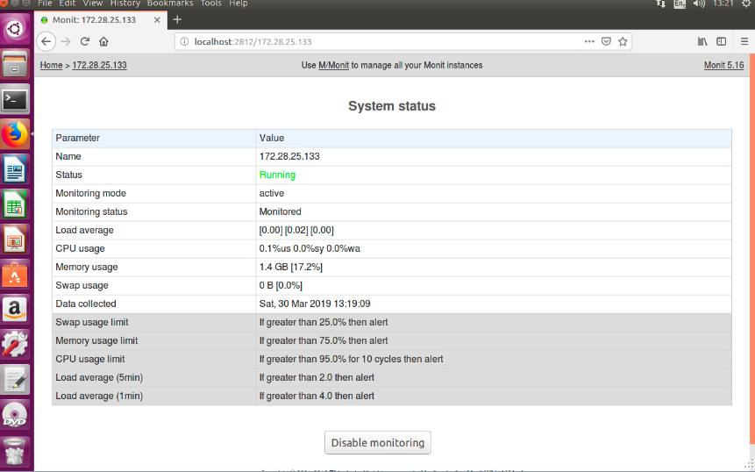
Monitoring tool : Monit Setup for Crowsoft

Slide 5
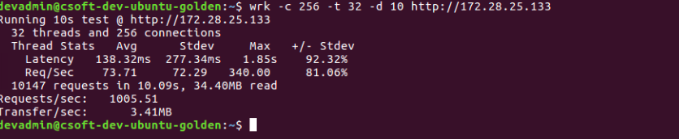
Performance analyser : Wrk Setup for Crowsoft
To run wrk on the application , issue the below command
$ wrk -c 256 -t 32 -d 10 http://172.28.25.133
Above is the application performance

Slide 6
Note
Need to fix sonarqube scanning for c# files
Make wrk and monit as a automation process in jenkins

